Slide 1
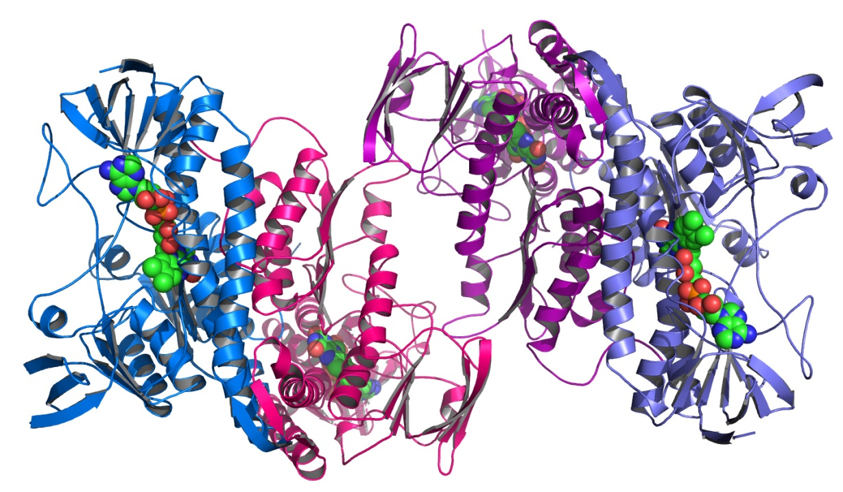
Statistical Thinking in Biology Research
Terry Neeman, PhD AStat
Statistical Consulting Unit (SCU)
John Dedman Building, ANU

Slide 2
A few key ideas for today’s lecture
Statistics in biology is the study of biological variation.
Statistical ideas about biological variation inform the design of experiments.
Statistical ideas about biological variation inform the analysis of experiments.
Statistical thinking is an essential component of scientific thinking.

Slide 3
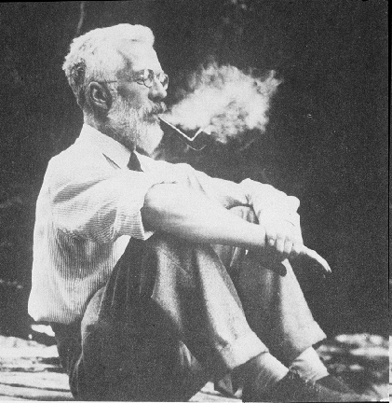
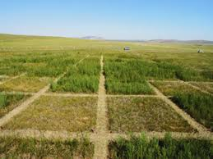
A bit of history of statistical methods in biology
R. A. Fisher: 1890 - 1962
Statistical Principles for Research Workers (1925)

Slide 4
Stories from the front
(cautionary tales)

Slide 5
Message 1: A small p-value is not always evidence of a treatment effect
Can adding rhizobacteria to soil improve N and phosphate absorption in roots?
6 plots/treatment (rhizo/control)
Root tissue sampled after 2 weeks
Samples pooled, and then sub-samples drawn
Outcome: relative mRNA expression of phosphate and N transporter genes in roots
Statistical method: t-tests, Bonferroni correction p<0.05.

Slide 6
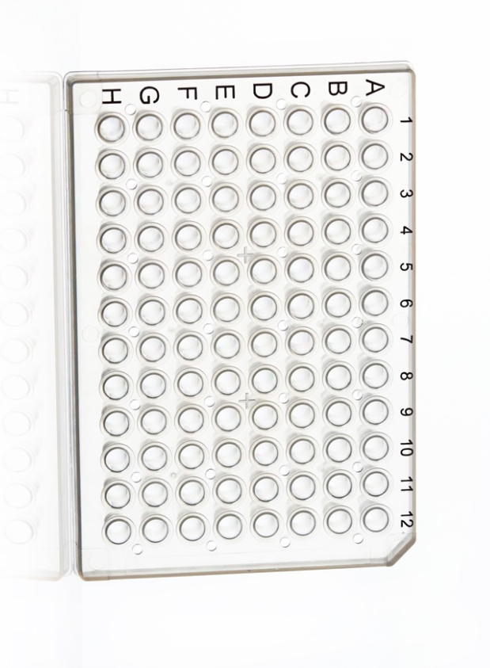
Can adding rhizobacteria to soil improve N and phosphate absorption in roots?
qPCR N and phosphate transporter genes
Field plan: 8 plots/treatment
Root tissue collected and pooled

Slide 7
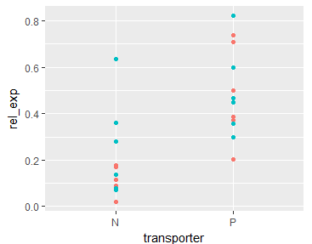
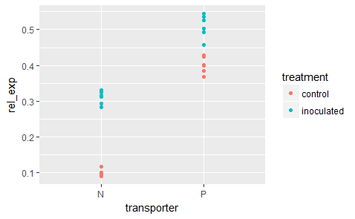
Does this experimental design measure biological variation or technical replication?
Biological variation Technical variation
To infer differences between treatments, we need to measure biological variation

Slide 8
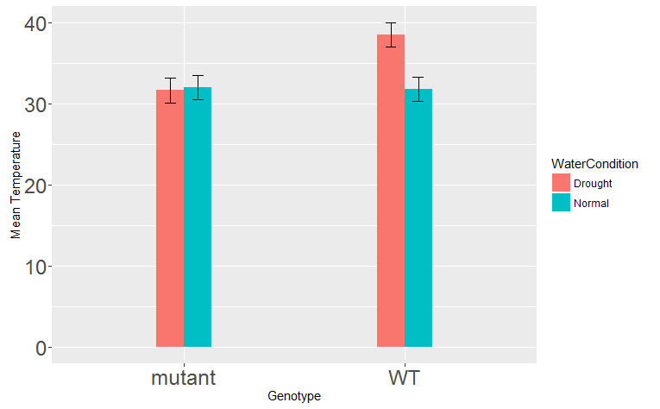
Message 2: p-values from simple comparisons cannot tell us when differences are “different”
Experimental set-up:
Are temperature mechanisms modified in
a genetically modified tomato plant?
Genotypes: WT/mutant
Water condition: Normal/Drought
Leaf temperature measured
Comparisons made using t-tests.
Evidence of difference + No evidence of difference ≠ Evidence that differences are different.

Slide 9
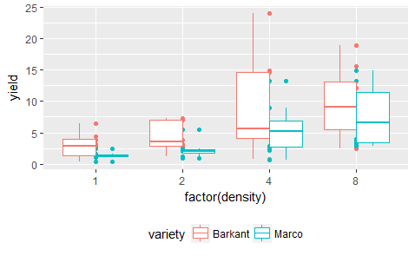
Message 3: Interpreting experimental results needs more than t-tests
Research question: Is crop yield of two turnip varieties differentially affected by planting density?
Experimental set-up:
2 turnip varieties – 32 observations/variety
4 growing densities: 1, 2, 4, 8 kg/ha
2 planting dates
Outcome measure: yield (kg/ha)
Acknowledgements: agridat package, R

Slide 10
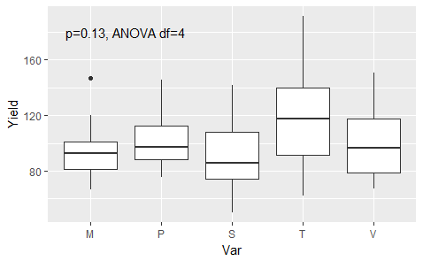
Message 4: Knowing how to combine information across subgroups can improve inference
Example 1: Comparing yield in five barley varieties (1930s)
Experimental factors: 5 varieties of barley, 6 locations, 2 time points
Outcome measure: yield
Acknowledgement: MASS package
in R
Notes:
Five varieties of barley were grown in six locations in each of 1931 and 1932.

Slide 11
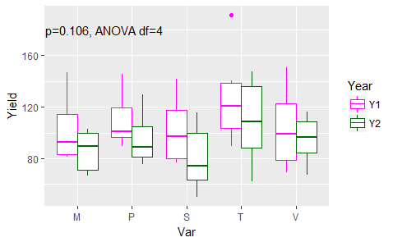
Message 4: Knowing how to combine information across subgroups can improve inference
Example 1: Comparing yield in five barley varieties (1930s)
Experimental factors: 5 varieties of barley, 6 locations, 2 time points
Outcome measure: yield
Note: Year is also a source of variation
“Controlling for year” =
Comparing yields WITHIN year and combining differences
Acknowledgement: MASS package
in R
Notes:
Five varieties of barley were grown in six locations in each of 1931 and 1932.

Slide 12
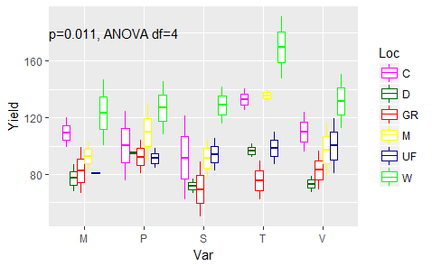
Message 4: Knowing how to combine information across subgroups can improve inference
Example 1: Comparing yield in five barley varieties (1930s)
Experimental factors: 5 varieties of barley, 6 locations, 2 time points
Outcome measure: yield
Note: Location is a BIG source of variation
“Controlling for location” =
Comparing yields WITHIN location and combining differences
Acknowledgement: MASS package
in R
Notes:
Five varieties of barley were grown in six locations in each of 1931 and 1932.

Slide 13
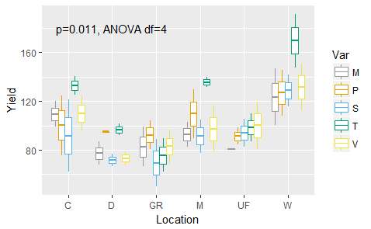
Message 4: Knowing how to combine information across subgroups can improve inference
Example 1: Comparing yield in five barley varieties (1930s)
Experimental factors: 5 varieties of barley, 6 locations, 2 time points
Outcome measure: yield
Note: Location is a BIG source of variation
“Controlling for location” =
Comparing yields WITHIN location and combining differences
What about controlling for location AND year?
Acknowledgement: MASS package in R
Notes:
Five varieties of barley were grown in six locations in each of 1931 and 1932.

Slide 14
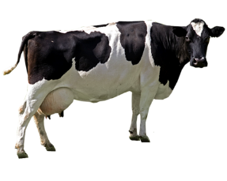
Message 5: Comparing treatments within units can improve inference
Example 2: Does diet affect milk yield in Holstein-Frisian cows?
Cows: 5 cows per treatment (10 cows total)
Experimental factors: 2 Diets (Hay&Corn + grain mixture)
Outcome measure: milk yield (lbs)
Period 1
Period 2
Period 3
T1
T2
T1
Group A
5 x
Diet T2
5 x
T2
T1
T2
Notes:
In this experiment, 10 cows were selected from the Iowa State College Holstein-Friesian herd and divided into two equal groups. Care was taken to have the groups as nearly equal as possible with regard to milk production, stage of gestation, body weight, condition and age. These cows were each given 10 pounds of timothy hay and 30 pounds of corn silage daily but were fed different grain mixtures. Treatment T1, then, consisted of feeding a grain mixture of 1 part of corn and cob meal to 1 part of ground oats, while treatment T2 consisted of feeding a grain mixture of 4 parts corn and cob meal, 4 parts of ground oats and 3 parts of gluten feed. The three treatment periods covered 105 days -- three periods of 35 days each. The yields for the first 7 days of each period were not considered because of the possible effect of the transition from one treatment to the other. The data, together with sums and differences which aid in the calculations incidental to testing, are given in table 2.
It seems safe to conclude that the inclusion of gluten feed in the grain mixture fed in a timothy hay ration to Holstein-Friesian cows increased the production of milk. The average increase was 21.7 pounds per cow for a 28-day period.

Slide 15
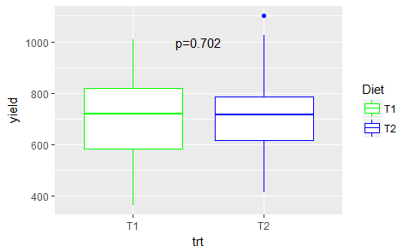
Does diet affect milk yield in Holstein-Frisian cows?
Yield by Treatment
Other sources of variation:
Period
Group
Cow
How can they improve our inference?
Notes:
But how to combine information across periods?

Slide 16
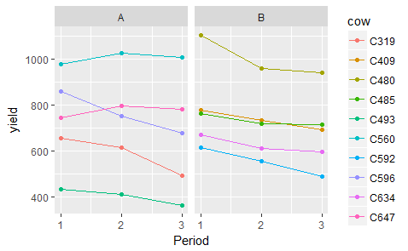
Does diet affect milk yield in Holstein-Frisian cows?
Yield by
Treatment
Period
Group
Cow
Observations:
P1: B>A (T2 better)
P2: A goes up (T2)
B goes down (T1)
P3: ??
T1 T2 T1 | T2 T1 T2
Notes:
But how to combine information across periods?

Slide 17
Summary so far
Message 1: A small p-value is not always evidence of a treatment effect.
Good experimental design matters.
Message 2: p-values from simple comparisons cannot tell us when differences are “different”.
Message 3: Interpreting experimental results needs more than t-tests
The analysis should match the scientific question of interest.
We need a statistical model of the experiment.
Message 4: Knowing how to combine information across subgroups can improve inference
A statistical model enables accumulation of evidence across experiments.
Message 5: Comparing treatments within units can improve inference
A statistical model can incorporate data structure for appropriate inference.

Slide 18

Chapter 1. Introduction to Statistical Modelling
Terry Neeman, PhD AStat
Statistical Consulting Unit (SCU)
John Dedman Building, ANU
(Note: this lecture requires the R packages ggplot2 and emmeans)

Slide 19
Introduction to Statistical Modelling- What is a model (data)?
Model – an informative summary of data
Model – a framework for inferring associations
Model – a framework for predicting future observations
Model – may take many different functional forms
Model – a conceptualisation of the experiment
ALWAYS BEGIN WITH A RESEARCH QUESTION

Slide 20
Key components of a statistical model of an experiment
Outcome measure
Response variable
Measure of interest
Experimental factors
Conditions that can be manipulated
Conditions of interest (e.g. genotype, gender)
Main questions: do the conditions impact upon the outcome measure?
Blocking factors – Data Structure
Conditions (not of interest) that may impact upon the outcome measure
Sources of variation in the experiment that need to be controlled for
Clustering of experimental units
ALWAYS BEGIN WITH A RESEARCH QUESTION

Slide 21
Key Objectives of a statistical model of an experiment
To compare the mean response of an organism/system to a set of different experimental conditions.
Obtain estimate of Treatment effect (mean difference)
Is this Treatment effect different in subgroups of interest?
What are the most important factors influencing the mean response?
Subsidiary question: how can we design our experiment in future to more efficiently estimate the Treatment effects?

Slide 22
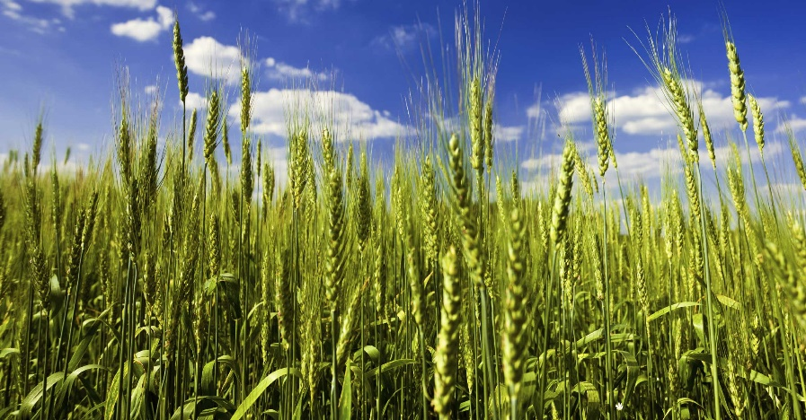
Example 1: Compare mean wheat yield between standard commercial and new variety
Outcome measure: Tonnes/hectare
Experimental factor: Variety (new/standard)
Data: 6 plots/ variety
From our data, we can calculate:
Observed overall mean wheat yield
Observed mean yield in STANDARD
Observed mean yield in NEW VARIETY
Variation around each mean

Slide 23
Example 1: Compare mean wheat yield between standard commercial and new variety
Outcome measure: Tonnes/hectare
Experimental factor: Variety (new/standard)
Data: 6 plots/ variety
THE STATISTICAL MODEL DESCRIBES
RELATIONSHIP BETWEEN THE MEAN YIELDS,
VARIATION AROUND THE MEANS
A is mean for STANDARD
D is mean difference between NEW and STANDARD
We would like to infer that D is different to 0.
A and D are called the PARAMETERS of the model.

Slide 24
Statistical models: Summary of an experiment 1) MEAN the patterns in the data the signals in the data 2) VARIATION around the MEAN the “noise” in the data
BIG QUESTION IN STATISTICS: Given our data:
How do we separate the “signal” from the “noise”?

Slide 25
The t-test is an example of a simple model, where:
Outcome measure
Continuous variable
Experimental factor
One factor: 2 conditions
Blocking factor – Data Structure
none
MEAN - GROUP A
MEAN – GROUP B
VARIATION around the means: to infer whether the “true” mean difference is different to 0

Slide 26
Example 1: Compare mean wheat yield between standard commercial and new variety
Outcome measure: Tonnes/hectare
Experimental factor: Variety (new/standard)
Data: 6 plots/ variety
How many parameters in this model?

Slide 27
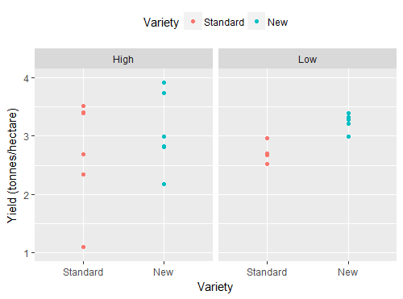
Which set of data shows greater evidence that New > Standard?
MEAN (Standard) = 2.8 t/hectare
MEAN (New) = 3.1 t/hectare
Notes:
When we look at the strength of evidence for a difference, it’s not enough to compare the mean values. In these two pictures, the means are around the same, but there’s much more variation in the first graph, so less able to draw conclusions. One has to consider the mean difference in the groups RELATIVE to the variation within the groups

Slide 28
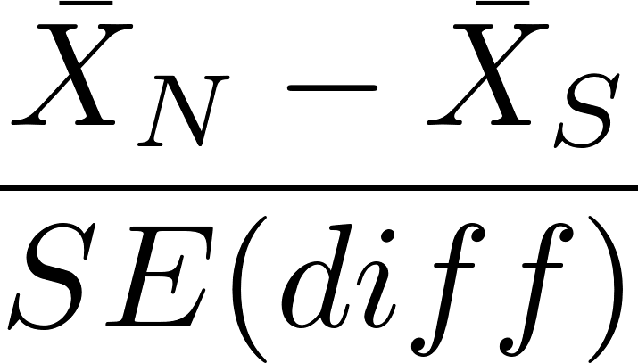
The t-test compares means between TWO groups
Between-group
mean differences
Standard error of the difference depends upon:
Sample sizes
Within-group variation

Slide 29
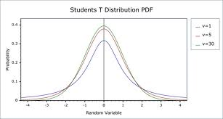
When μ_{V} = μ_{S}
t distribution symmetric around 0
t-values around 0 are the most common
t-values > |2| unlikely

Slide 30
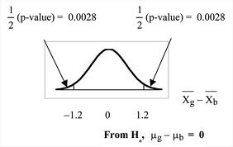
p-value: probability (area under curve) of getting a value as extreme as what you observed, when μ_{V} = μ_{S}

Slide 31
Analyse these data in R
Set up working directory and import data
setwd(“~/Dropbox/CSIRO short course/Data”)
wheat<-read.csv(“wheat yield.csv”)
str(wheat) #check data types for each variable
View(wheat) #View data
wheat$Variety<-relevel(wheat$Variety, ref=“Standard”) # set reference level
Visualise data
library(ggplot2)
ggplot(wheat, aes(Variety, Yield, colour=Variety)) + geom_point() +
facet_wrap(~Variation)

Slide 32
Sample analysis in R: t-test
Subset data by Variation (High and Low)
wheat_H<- subset(wheat,Variation=“High”)
wheat_L<- subset(wheat,Variation=“Low”)
Compare Varieties in “High Variation” subset
> t.test(Yield~Variety, data=wheat_H, var.equal=TRUE)
t = 0.93776, df = 10, p-value = 0.3705
alternative hypothesis: true difference in means is not equal to 0
95 percent confidence interval:
-0.7181446 1.7619349
mean in group New mean in group Standard
3.241916 2.720021

Slide 33
Sample analysis in R: t-test
Subset data by Variation (High and Low)
wheat_H<- subset(wheat,Variation=“High”)
wheat_L<- subset(wheat,Variation=“Low”)
Compare Varieties in “Low Variation” subset
> t.test(Yield~Variety, data=wheat_L, var.equal=TRUE)
t = 3.9816, df = 10, p-value = 0.002594
alternative hypothesis: true difference in means is not equal to 0
95 percent confidence interval:
0.1948069 0.6898950
sample estimates:
mean in group New mean in group Standard
3.260917 2.818566

Slide 34
Fit a linear model in R: lm
>
lm1<-lm(Yield ~ Variety, data = wheat_L)
anova(lm1)
Analysis of Variance Table
Response: Yield
Df Sum Sq Mean Sq F value Pr(>F)
Variety 1 0.58702 0.58702 15.853 0.002594 **
Residuals 10 0.37029 0.03703
summary(lm1)
Coefficients:
Estimate Std. Error t value Pr(>|t|)
(Intercept) 2.81857 0.07856 35.878 6.72e-12 ***
VarietyNew 0.44235 0.11110 3.982 0.00259 **

Slide 35
Fit a linear model in R: lm
>
MODEL PARAMETERS
Lm1<-lm(Yield~Variety, data = wheat)
summary(lm1)
Coefficients:
Estimate Std. Error t value Pr(>|t|)
(Intercept) 2.81857 0.07856 35.878 6.72e-12 ***
VarietyNew 0.44235 0.11110 3.982 0.00259 **
library(emmeans)
emmeans(lm1, ~Variety)
Variety emmean SE df lower.CL upper.CL
Standard 2.818 0.0785 10 2.64 2.99
New 3.260 0.0785 10 3.08 3.43
MODEL PARAMETERS (a different parameterisation)

Slide 36
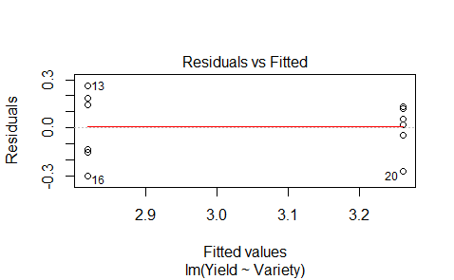

Assessing model assumptions in R
>
$$ε\sim N\left(0,σ^{2}\right)$$
plot(lm1, which=1)

Slide 37
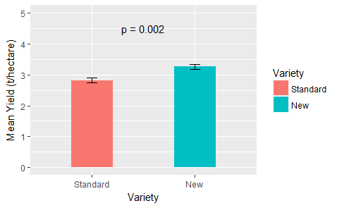
Reporting results from this experiment
lm1.results<-summary(emmeans(lm1,~Variety))
ggplot(lm1.results,aes(Variety,emmean))+
geom_bar(stat="identity", width=.4)+
geom_errorbar(aes(ymin = , ymax = ) + #incomplete
ylim(0,5)+
labs(y = “Mean Yield (t/hectare)")

Slide 38
1-way ANOVA is an example of a simple model, where the outcome measure is a continuous variable and the single experimental factor has 2 OR MORE levels

Slide 39
Compare wheat yields between 3 varieties
Outcome measure: Tonnes/hectare
Experimental factor: Variety (new/newPLUS/standard)
Data: 6 plots/ variety
.
How many parameters in this model?

Slide 40
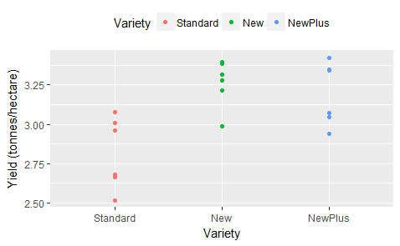
Results from Wheat Yield Experiment with 3 Varieties
Notes:
As before, if the variation around each of the means is large, then it is obviously harder to be sure of a difference between the groups.

Slide 41
ANOVA compares means between TWO or MORE POPULATIONS
Between-group
mean variation
Within-group variation

Slide 42
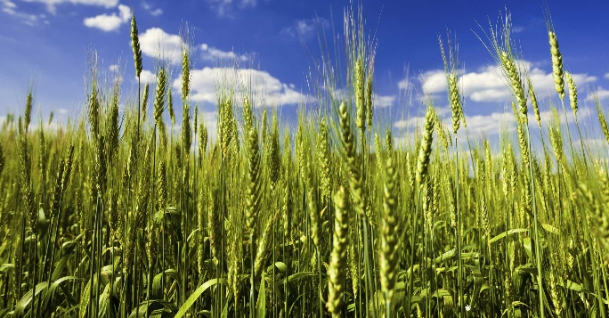
Analyse these data in R
Set up working directory and import data
setwd(“~/Dropbox/CSIRO short course/Data”)
wheat2<-read.csv(“wheat yield PLUS.csv”)
str(wheat2) #check data types for each variable
View(wheat2) #View data
Visualise data
library(ggplot2)
ggplot(wheat2, aes(Variety, Yield, colour=Variety)) +
geom_point()

Slide 43
Sample analysis in R: 1-way ANOVA
aov1=aov(Yield~Variety, data = wheat2)
summary(aov1)
Df Sum Sq Mean Sq F value Pr(>F)
Variety 2 0.6820 0.3410 8.951 0.00276 **
Residuals 15 0.5714 0.0381
But which groups are different???

Slide 44
Summary of results:
library(emmeans)
emmeans(aov1, ~Variety)
Variety emmean SE df lower.CL upper.CL
Standard 2.81 0.079 15 2.64 2.98
New 3.26 0.079 15 3.09 3.43
NewPlus 3.19 0.079 15 3.02 3.36
Confidence level used: 0.95
But which groups are different???

Slide 45
Post hoc comparisons:
library(emmeans)
emmeans(aov1, pairwise~Variety)
$contrasts
contrast estimate SE df t.ratio p.value
Standard - New -0.44 0.112 15 -3.925 0.0036
Standard – NewPlus -0.37 0.112 15 -3.330 0.0120
New - NewPlus 0.06 0.112 15 0.595 0.8248
P value adjustment: tukey method for comparing a family of 3 estimates

Slide 46
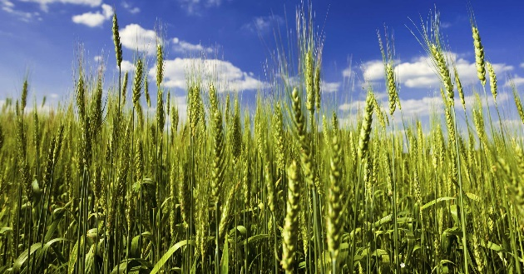
Fit a linear model in R: lm
lm2<-lm(Yield ~ Variety, data = wheat2)
anova(lm2)
Analysis of Variance Table
Response: Yield
Df Sum Sq Mean Sq F value Pr(>F)
Variety 2 0.68203 0.34101 8.9513 0.002764 **
Residuals 15 0.57145 0.03810
summary(lm2)
Coefficients:
Estimate Std. Error t value Pr(>|t|)
(Intercept) 2.81857 0.07968 35.372 7.26e-16 ***
VarietyNew 0.44235 0.11269 3.925 0.00135 **
VarietyNewPlus 0.37529 0.11269 3.330 0.00457 **

Slide 47
Fit a linear model in R: lm
emmeans(lm2, pairwise~Variety)
$emmeans
Variety emmean SE df lower.CL upper.CL
Standard 2.81 0.0796 15 2.64 2.98
New 3.26 0.0796 15 3.09 3.43
NewPlus 3.19 0.0796 15 3.02 3.36
Confidence level used: 0.95
$contrasts
contrast estimate SE df t.ratio p.value
Standard - New -0.44 0.112 15 -3.925 0.0036
Standard - NewPlus -0.37 0.112 15 -3.330 0.0120
New - NewPlus 0.067 0.112 15 0.595 0.8248
P value adjustment: tukey method for comparing a family of 3 estimates

Slide 48
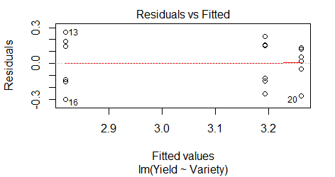
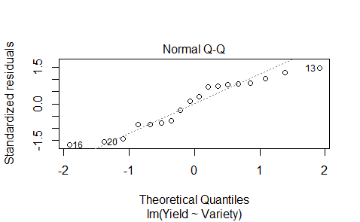

Assessing model assumptions in R
>
$$ε\sim N\left(0,σ^{2}\right)$$
plot(lm2,which=c(1,2))

Slide 49
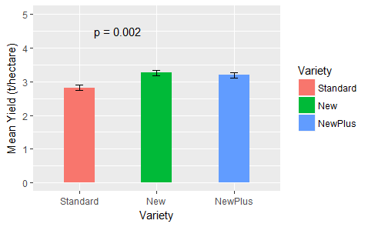
Summary of results with post hoc comparisons:

Slide 50
Chapter 2. Introduction to Experimental Design
Terry Neeman, PhD AStat
Statistical Consulting Unit (SCU)
John Dedman Building, ANU

Slide 51
The principles of experimental design were codified ~100 years ago
R. A. Fisher: 1890 - 1962
Statistical Principles for Research Workers (1925)

Slide 52

What drives the thinking behind experimental design?
How do we know that the difference we observed is due to treatment, genotype, variety, etc?
Could the effect we are observing be due to another factor?
Are the potential sources of bias that could be influencing the outcome?
How can we reduce the “noise” in the experiment to see the treatment effects more clearly?

Slide 53
KEY PRINCIPLES in Experimental Design
CONTROLS
REPLICATION
BLOCKING
RANDOMISATION
BLINDING
Notes:
This is not a really old subject. Goes back about 90 years to agricultural experiments in the 1920s and 30s.

Slide 54
KEY PRINCIPLES in Experimental Design and Analysis
CONTROLS:
Direct comparison with a known standard or no treatment.
Tested under identical conditions to experimental treatment.
REPLICATION
BLOCKING
RANDOMISATION
BLINDING

Slide 55
KEY PRINCIPLES in Experimental Design and Analysis
CONTROLS
Direct comparison with a known standard or no treatment.
Tested under identical conditions to experimental treatment.
REPLICATION: repeating experiment on different samples to:
(1) increase precision of treatment effect
(2) make result more generalisable
BLOCKING
RANDOMISATION
BLINDING
Notes:
This is not a really old subject. Goes back about 90 years to agricultural experiments in the 1920s and 30s.

Slide 56
KEY PRINCIPLES in Experimental Design and Analysis
CONTROLS
Direct comparison with a known standard or no treatment.
Tested under identical conditions to experimental treatment.
REPLICATION: repeating experiment on different samples to:
(1) increase precision of treatment effect
(2) make result more generalisable
BLOCKING:
Grouping together similar experimental units, &
Comparing treatments within homogeneous groups
RANDOMISATION
BLINDING
Notes:
This is not a really old subject. Goes back about 90 years to agricultural experiments in the 1920s and 30s.

Slide 57
KEY PRINCIPLES in Experimental Design and Analysis
CONTROLS
Direct comparison with a known standard or no treatment.
Tested under identical conditions to experimental treatment.
REPLICATION repeating experiment on different samples to:
(1) increase precision of treatment effect
(2) make result more generalizable
BLOCKING
Grouping together similar experimental units, &
Comparing treatments within homogeneous groups
RANDOMISATION: probabilistic process of making treatment assignments. Consider also randomising order of testing.
BLINDING
Notes:
This is not a really old subject. Goes back about 90 years to agricultural experiments in the 1920s and 30s.

Slide 58
KEY PRINCIPLES in Experimental Design and Analysis
CONTROLS
Direct comparison with a known standard or no treatment.
Tested under identical conditions to experimental treatment.
BLOCKING
Grouping together similar experimental units, &
Comparing treatments within homogeneous groups
REPLICATION repeating experiment on different samples to:
(1) increase precision of treatment effect
(2) make result more generalisable
RANDOMISATION probabilistic process of making treatment assignments. Consider also randomising order of testing.
BLINDING: masking treatment assignment. Blinding includes:
Allocation blinded
Evaluator blinded
Notes:
This is not a really old subject. Goes back about 90 years to agricultural experiments in the 1920s and 30s.

Slide 59
Example: Converging on an experimental design using key principles
Research topic:
How is seedling emergence (in Banksia) influenced by temperature and moisture?
Set up: 12 shelters, 2 garden beds per shelter, 24 pots per bed.
Experimental factors:
Temperature (2 levels) Water (3 levels) Species (4 levels) Populations (2/species)
24 pots
8 rows
3 cols
24 pots
8 rows
3 cols
Sample shelter: 5x5 m^2
Adapted from Cochrane et al. Oikos (2014)

Slide 60
How to distribute treatments across 12 shelters?
8 populations from 4 Banksia species, 2 temperatures, 3 watering conditions, 48 pots/shelter

Slide 61
How to distribute treatments across 12 shelters? What’s wrong with this design?
SPECIES A
SPECIES B
Low water
Med water
High water
Low water
Med water
High water
SPECIES C
SPECIES D
Low water
Med water
High water
Low water
Med water
High water
8 populations from 4 Banksia species, 2 temperatures, 3 watering conditions, 48 pots/shelter

Slide 62
KEY PRINCIPLES in Experimental Design and Analysis
CONTROLS: Can’t compare A/B with C/D
BLOCKING: Shed can be a block, but there are no comparisons within a shed
REPLICATION: too much clustering of the same units means reduced amount of information about treatments
RANDOMISATION: think first about blocking…

Slide 63
How to distribute treatments across 12 shelters? How about this design? (repeat A/B/C/D in each shelter)
A B
C D
Low water
Med water
High water
Low water
Med water
High water
Low water
Med water
High water
Low water
Med water
High water
8 populations from 4 Banksia species, 2 temperatures, 3 watering conditions, 48 pots/shelter

Slide 64
KEY PRINCIPLES in Experimental Design and Analysis
CONTROLS: Can compare between species WITHIN a shed
BLOCKING: Shed can be a block, but there are no comparisons within a shed. Temperature/Water effects are compared BETWEEN sheds
REPLICATION: too much clustering of the same units means reduced amount of information about Temperature/Water effects
RANDOMISATION: think first about blocking…

Slide 65
How to distribute treatments across 12 shelters? How about this design? (repeat A/B/C/D in each shelter)
A B
C D
Low water
Med water
High water
Low water
Med water
High water
Low water
Med water
High water
Low water
Med water
High water
8 populations from 4 Banksia species, 2 temperatures, 3 watering conditions, 48 pots/shelter

Slide 66
KEY PRINCIPLES in Experimental Design and Analysis
CONTROLS: Can compare species WITHIN a shed, Temperature WITHIN shed
BLOCKING: Water effects are compared BETWEEN sheds
REPLICATION: too much clustering of the same units means reduced amount of information about Water effects
RANDOMISATION: think first about blocking…

Slide 67
Complete Randomised Block Design How do we arrange the pots within the shed?
TEMP 1 TEMP 2
x12
A & B & C & D
A & B & C & D
Low Med High Med High Low

Slide 68

Complete Randomised Block Design How do we arrange the pots within the shed?
Ideas?
What about Column effects?
What about position within the column?
Can we randomise the pots?

Slide 69
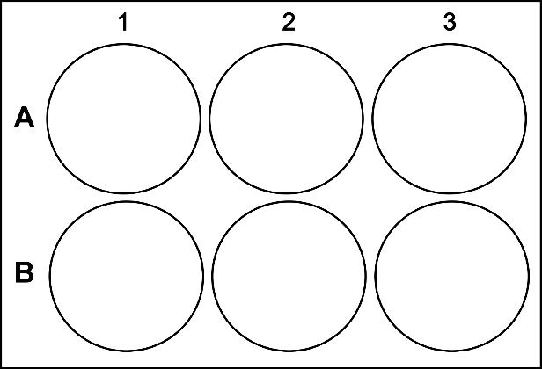
How can the design of this experiment (control + 2 treatments) be improved?
C
T1
T2
C
T1
T2
C
T1
T2
C
T1
T2
C
T1
T2
C
T1
T2
C
T1
T2
C
T1
T2
C
T1
T2
C
T1
T2
C
T1
T2
C
T1
T2
Day 1
Day 2
Day 3

Slide 70
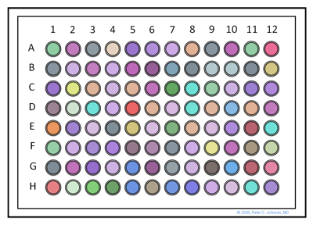
What are the possible sources of variation on a plate for (i) PCR experiment, or (ii) cell viability experiment?

Slide 71
Readings
Chapter 3, Statistical methods in biology, Welham et al
Kilkenny et al ARRIVE guidelines
Ten Simple Rules for Effective Statistical Practice

